Slide 1

Photon and Neutron Open Science Cloud
R. Dimper
on behalf of the PaNOSC consortium
13 November 2018

Slide 2

Research data challenges
Recall: New science = a lot of data!
Hurdles for users of our RIs:
Quantity of data generated too big to transfer
Availability of adequate software can be problematic
Big data need big computing resources
New users: non-experts, need help in their data analysis
Long term storage of the data (regulations and requirements)
The PaNOSC partners operate large-scale RIs that are part of Europe’s big-data science factories.
They face common challenges, shared by many other RIs in Europe.

Slide 3

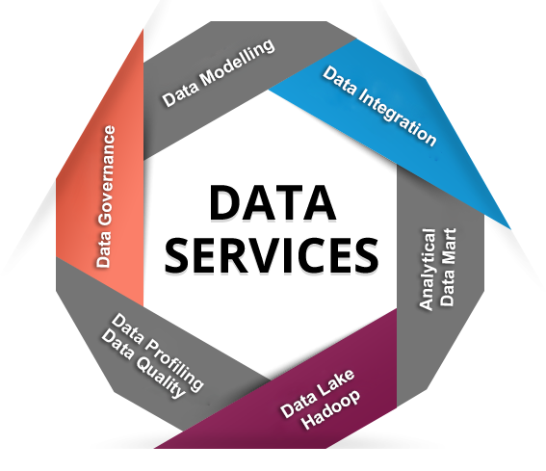
PaNOSC Goals
Data Stewardship
Generalise the adoption of FAIR open data principles
EOSC
Federate data catalogs and integrate in EOSC and OpenAire meta-catalog, AAI, download services
Data Services
Develop new data analysis, modelling and simulation services
User Training
Train users how to write Data management plans, improve metadata, using DOIs, manage data better

Slide 4








PaNOSC H2020 project
H2020 proposal to INFRAEOSC-4
Partners: ESRF, ILL, XFEL.EU, ESS, CERIC-ERIC, ELI, EGI
Observers/non-funded: GÉANT, EUDAT, national RIs
Linked 3rd parties via EGI: DESY, STFC Decision: Accepted on 13/8/2018
Status: Grant Agreement signed
Budget: 12 M€
Coordinator: ESRF
Planned start date: 1/1/2019
Project duration: 4 years
Kick-off meeting planned
for 15-16 January at ESRF
Photon and Neutron Open Science Cloud

Slide 5
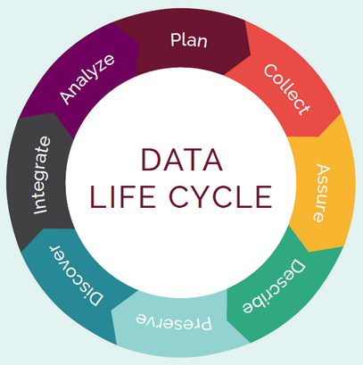



PaNOSC will provide
Curated Open scientific data and metadata of the highest quality
Reliable data analysis services dedicated to understanding and to further exploiting these data
Technical and scientific support on these data and data services
Implementation guidelines for FAIR data in Photon and Neutron science
Our knowledge and understanding of our scientific community
Our ability to promote FAIR culture amongst our community
Link ESFRIs to the EOSC and make it useful for our community
Photon and Neutron Open Science Cloud

Slide 6
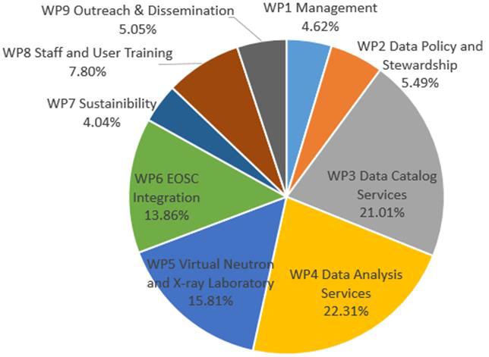
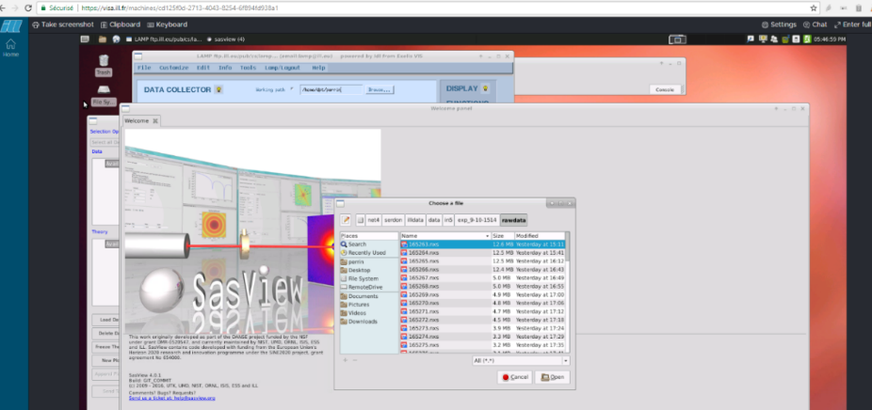
PaNOSC work packages
WP1 – 64 months, Management (lead: ESRF)
WP2 – 76 months, Data policy and stewardship (lead: ESRF)
WP3 – 291 months, Data catalogue services (lead: ESS)
WP4 – 309 months, Data analysis services (lead: XFEL)
WP5 – 219 months, Virtual Neutron and X-ray lab (lead: XFEL)
WP6 – 192 months, EOSC integration (lead: ILL)
WP7 – 56 months, Sustainability (lead: CERIC)
WP8 – 108 months, User training (lead: ESS)
WP9 – 70 months, Outreach led (lead: CERIC)
DAAS services
Remote desktop
Jupyter notebook

Slide 7
10 challenges for RIs and EOSC to work together
FAIR data – more difficult to implement than most believe
Scalability of services - catering for the needs of small research groups from public and private sectors, as well as very large experiments
Integration - services linked by a supported federated identity scheme covering more of the research life cycle where users access data, software, IT capacity and the expertise for performing analysis
Hybrid model - should not compete with but rather profit from ease of use and rates of innovation of commercial service providers
Provenance, citation and use of data & software that respects intellectual property rights
Software licence models that allow flow of data across different infrastructures without buying licences for each one
Confidentiality of data that is still under embargo for publication or intellectual property reasons
Cyber security vulnerabilities must not compromise participating organisations
Adoption - making end users aware of the services and encouraging them to use them
A Governance model that ensures an end‐users driven decision making process

Slide 8

PaNOSC Observer Status
Terms of Reference not fully defined yet
Basic principles:
One Observer per lab designated by the respective lab management
The Observer can nominate an acting to stand in
Observers can attend ALL meetings and the telcos of the Work Packages but not the general management telcos nor the Executive Committee
Observers have access to all deliverables and design documents
Observers have to cover their own travel and subsistence costs

Slide 9
Conclusions
Conclusion
PaNOSC is an opportunity for all partners to harmonise their data policies, provide data services and help user learn and adopt modern FAIR data management principles
PaNOSC is an opportunity to integrate the PaNOSC partners with the European Open Science Cloud and e-infrastructure platforms i.e. EGI
PaNOSC is complementary to LEAPS and preparing the LEAPS IT road map
PaNOSC is welcoming all national PaNs to join as observers
PaNOSC is looking forward to establishing close links with ExPaNDS

